Slide 1
Java programming #5 RegEx, Generics, JavaDoc
Dmitry Chub
@dmchub

Slide 2
Regular expression
Regular expression -- is a sequence of characters that define a search pattern

Slide 3

The idea of RegEx
Match text against pattern to find out, whether text fits in pattern or not
RegEx
a.b
Text
axb
Text
RegEx

Slide 4
RegEx in Java
Package java.util.regex
Pattern -- compiled representation of a regular expression.
Matcher -- engine that performs match operations on a character sequence by interpreting a Pattern.

Slide 5
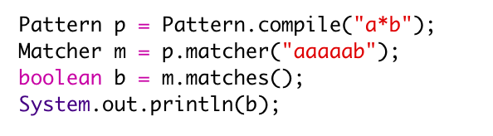
Simple example

Slide 6
Bonus
Online RegEx IDE
https://www.freeformatter.com/java-regex-tester.html

Slide 7
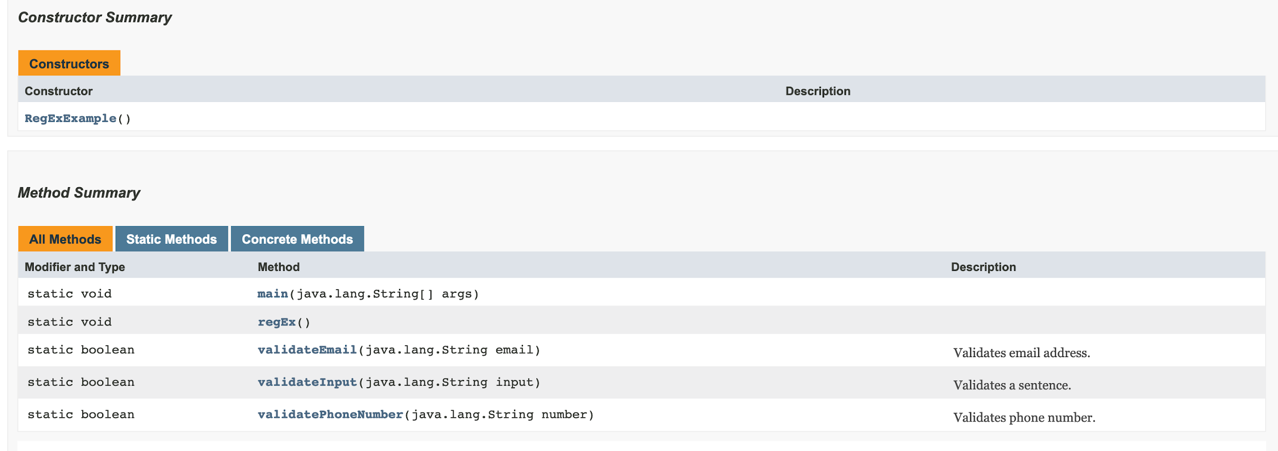
JavaDoc

Slide 8
JavaDoc descriptors
Descriptor | Where to use | Description
@author | Class, Interface | Author of this object
@version | Class, Interface | Version of object
@since | Class, Interface, field, method | Available since some version
@see | Class, Interface, field, method | LInk to object
@param | Method | Description of parameter
@return | Method | Description of return value
@throws | Method | Description of exception that can be thrown
@deprecated | Class, Interface, field, method | Deprecated since version
{@link reference} | Class, Interface, field, method | Link to website

Slide 9
Enum
enum Day {
MONDAY,
TUESDAY,
WEDNESDAY,
THURSDAY,
FRIDAY,
SATURDAY,
SUNDAY
}

Slide 10
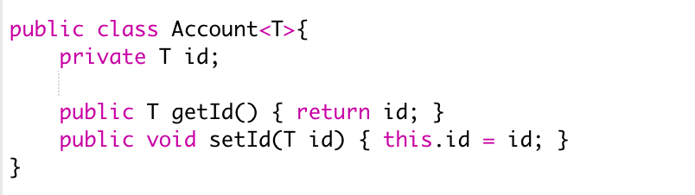
Generics

Slide 11
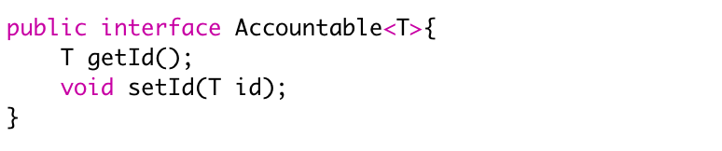
Generic interface

